Slide 1
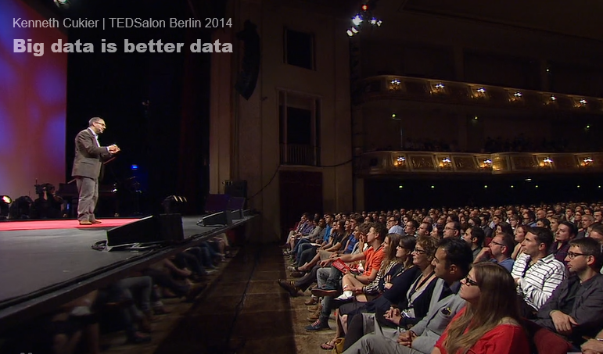
Final Project Presentation
Samuel Kadyebo
Kumar Pankaj
Travellanzy

Slide 2
Presentaion
Motivation For Our Project Idea
Three Segments including:
Introduction
Implementation
Illustration

Slide 3
Introduction
Present basic information on Big Data composites
Introduce It’s Relevancy in the Scheme of things Big Data
key concepts including:
RDBMS, MySQL, NoSQL, MongoDB

Slide 4
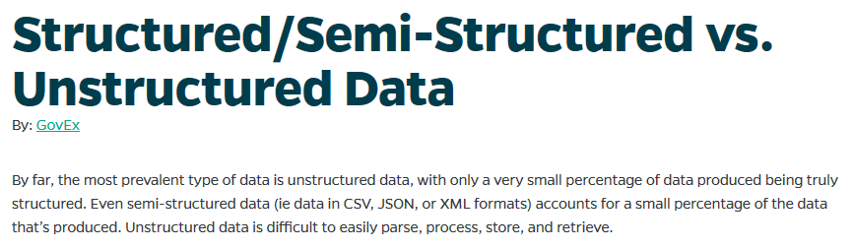
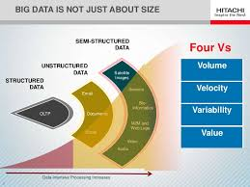

Slide 5
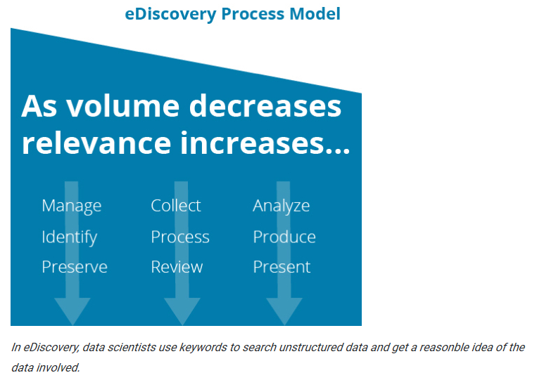

Slide 6


Slide 7


Slide 8
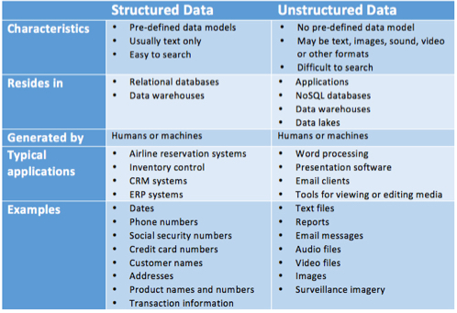

Slide 9
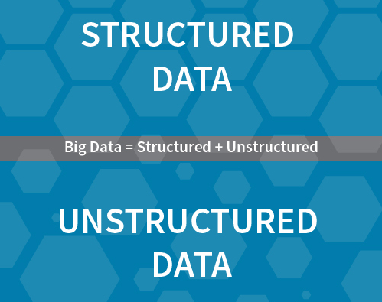

Slide 10
Comparing MySQL and MongoDB
Present basic information Relational Database Management System (RDBMS) and NoSQ

Slide 11
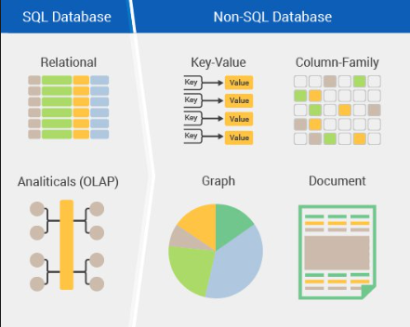

Slide 12
Implementation
SQL + NoSQL using Command Query Responsibility Segregation (CQRS)
How to use Tungsten Replicator to migrate data from MySQL to MongoDB
Tie it together with Rest API

Slide 13
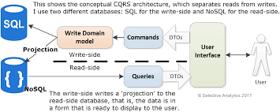
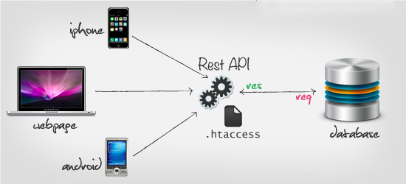

Slide 14
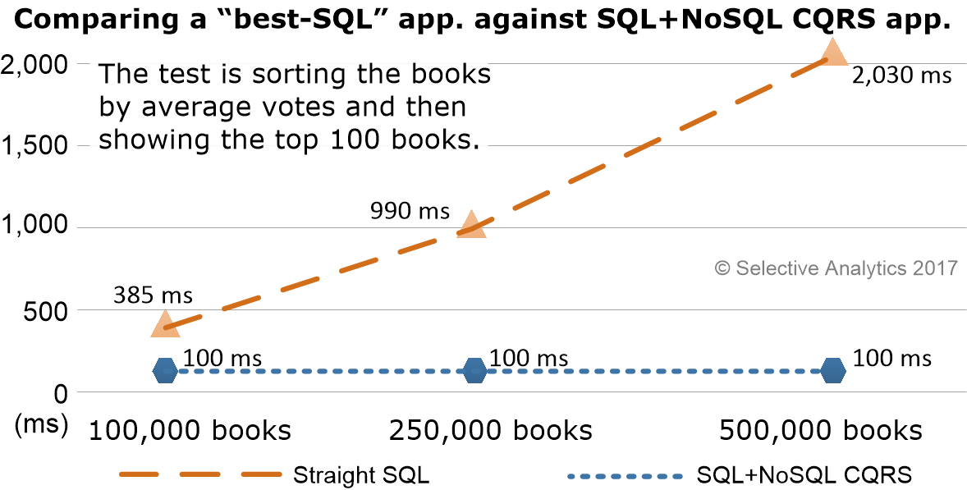
EF Core CQRS
CQRS is a query creating with Entity Framework (EF), an open source object relational mapping (ORM) Framework
Data is written to primary SQL Database
Database uses NoSQL read-side build

Slide 15
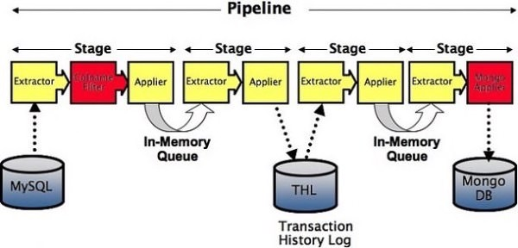
Tungsten Replicator
Data is read from the rows
Corresponding columns and primary keys are identified
Translated to Binary JSON (BSON), stored in THL and applied to MongoDB

Slide 16
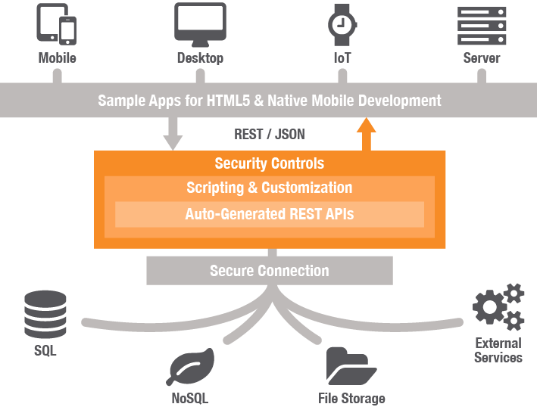

Slide 17
Illustration
How companies incorporate MySQL and MongoDB into their Databases
OpenSky the first E-Commerce site to migrate to MongoDB
Craigslist migrating from exclusively from MySQL to using MySQL and MongoDB
We do hereof: A Travel Repository Prototype

Slide 18
Craigslist and OpenSky
Craigslist
Archive utilizes MongoDB
Live listings is stored on a MySQL database
Opensky
Catalog takes advantage of MongoDB’s flexibility
Order management is stored with MySQL

Slide 19

Travel Repository
Prototype

Slide 20

Questions ?

